Slide 1
Techno-Economic Analysis of Engineering Projects (basic elements) Manuel de Oliveira Duarte

Slide 2
About the nature of Engineering Projects (1)
An engineering project is a set of planned activities targeted at solving problems, answering needs or exploiting opportunities and, therefore, having the purpose of generating benefits during a certain period of time.
Planning of engineering projects involves two fundamental alpects:
Time spent in the implementation of the project.
Costs associated with the mobilised resources .

Slide 3
Phases of an engineering project
About the nature of Engineering Projects (2)

Slide 4
About the nature of Engineering Projects (3)
Engineering projects require resources of different nature:
Human resources.
Equipment (e.g.: machinery, tools, furniture, etc).
Software (bought with certain usage rigths).
Buildings or other real estate (e.g.: land to grow crops for an agricultural enterprise).
Consumables (e.g.: office materials, fuel bought to heat a boiler and other goods that might be spent or wasted).
Services contracted to third parties such as energy and communications provision, cleaning, maintenance, etc).
Licences and other rights (patents, authorship rights, etc).

Slide 5
Techno-Economic Analysis of Engineering Projects (1)
Before going ahead with a project it is necessary to assess its economic feasibility. This is done trough a techno-economic analysis.
The techno-economic evaluation of a project involves the following steps:
Identification of the possible technical solutions for the problem, need or opportunity under consideration.
Quantification of the financial scenarios associated with the identified technical solutions.
Several financial indicators might be used for this quantification. The following will be considered :
Net Present Value
Internal Rate of Return
Payback Period

Slide 6
Techno-Economic Analysis of Engineering Projects (2)
In addition to the technical and financial aspects, sometimes it is also necessary to pay attention to issues of other nature such as social, regulatory, echological, etc issues.
Normally a project involves risks and uncertainty.
To deal with risks it is commom to elaborate contingency plans specifying what shoud be done in case of the materialization of the identified risks.
To deal with uncertainty is is commomm to build scenarios representing the range of possible working conditions (“What If” Analysis).

Slide 7
Techno-Economic Analysis of Engineering Projects (3)
Difficult questions appear:
Who are our clients?
How many are they?
How long will it take for them to buy our product/service?
Where are they?
How can we reach them?
Via physical stores?
Via the web?
How much are they willing to pay?
How much is it necessary to invest and over how long?
Are we going to face competition?
Are there any regulations that must be obeyed to sell our product/service?

Slide 8
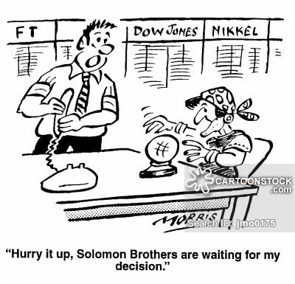
Unfortunately, engineers do not have a crystal ball to guess how markets will behave in relation to the appearence of a new technology, service or product.
Techno-Economic Analysis of Engineering Projects (4)
https://www.cartoonstock.com/directory/c/crystal_ball_readers.asp

Slide 9

Techno-Economic Analysis of Engineering Projects (5)
But… it is also possible to learn with the past: ⁽¹⁾
Source: https://www.cartoonstock.com/directory/c/cassandra.asp, seen at: 20200317.

Slide 10
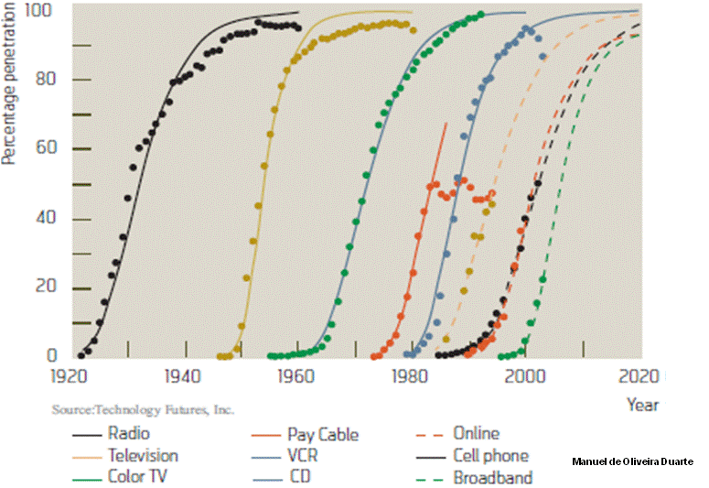
Techno-Economic Analysis of Engineering Projects (6)
… looking at trends of how markets reacted to new products, services and technologies: ⁽¹⁾
Source: L. K. Vanston, R.L. Hodges, “Technology forecasting for telecommunications”, Telektronikk 4.04, pp. 32-42, 2004.

Slide 11
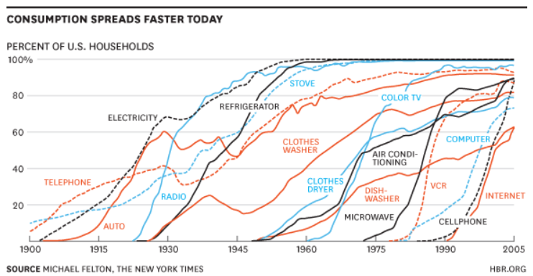
Techno-Economic Analysis of Engineering Projects (7)
Trends from the past (2)
http://www.alkane.com.au/exponential-growth-of-electric-vehicles-make-rare-earths-extremely-valuable/

Slide 12
Techno-Economic Analysis of Engineering Projects (8)
It is case to ask:
“What can explain that products, services and technologies as diverse as those to which the previous figures relate have so similar patterns of adoption?”
To help address this issue consider the companion document:
Modelos Matemáticos para os Processos de Adopção de Tecnologias, Produtos e Serviços: Breve Introdução
A.Manuel de Oliveira Duarte, Universidade de Aveiro, 2020
The above reference provides the following model for the patterns of adoption of new products, services and technologies:

Slide 13
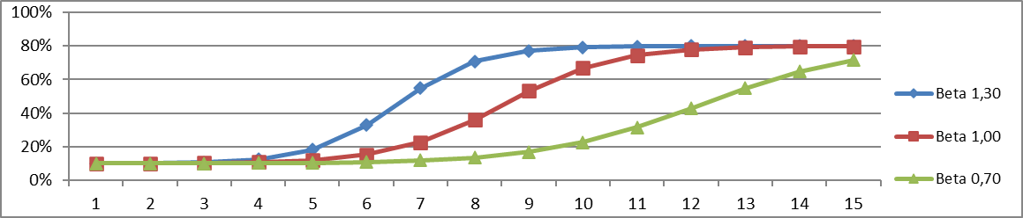
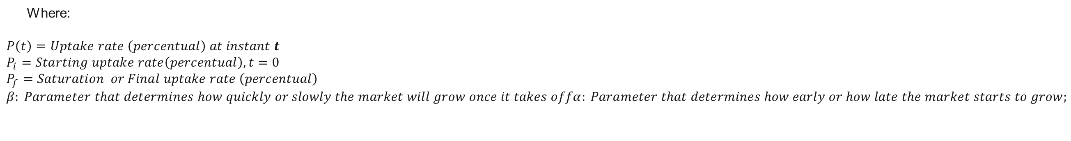
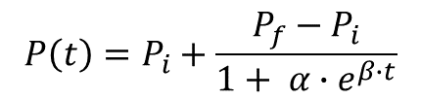
Techno-Economic Analysis of Engineering Projects (9)
$$P\left(t\right)=P_{i}+\frac{P_{f}−P_{i}}{1+ α∙e^{β∙t}}$$
Where:
$$P\left(t\right)=Uptake rate \left(percentual\right) at instant t$$
$$P_{i}=Starting uptake rate\left(percentual\right), t=0$$
$$P_{f}=Saturation or Final uptake rate \left(percentual\right)$$
$$β: Parameter that determines how quickly or slowly the market will grow once it takes offα: Parameter that determines how early or how late the market starts to grow;$$

Slide 14
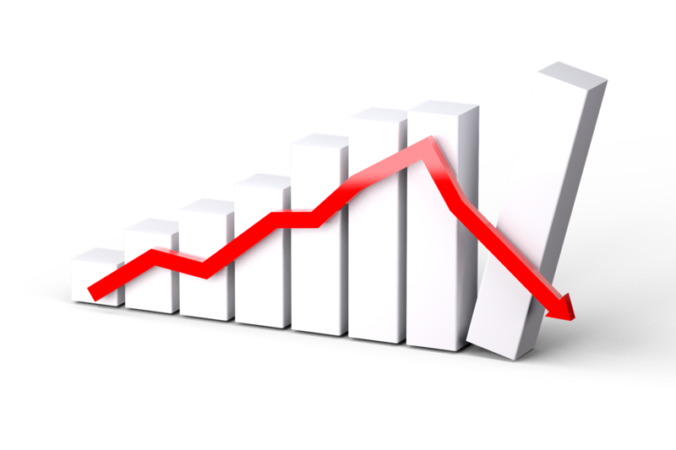
Techno-Economic Analysis of Engineering Projects (10)
Unfortunately, sometimes a certain vírus appears and…
Source: https://www.hawaiipublicradio.org/post/conversation-hawaii-economic-forecast-down-due-covid-19#stream/0, seen: 20200317.

Slide 15
Essential Elements
of
Project Economics

Slide 16
Essential Elements of Project Economics (1)
The economics of an engineering project involves some essential elements:
Time:
Every project as a time to start and a time to end.
This implies the need for planning the expected flows of spending and revenues over time, as a function of expected activities.
Capital expenditure (CAPEX)
This relates to all spending in capital goods
(e.g.: buildings, durable equipment, basic infrastructures such as ducts and cables, tradable patents, etc).
Operational expenditure (OPEX)
This relates to all spending in the aquisition of consumables and services (e.g.: labour, communications, energy, etc).
Revenues:
This relates to all possible incomes that might be generated by the project (sales, royalties, etc).

Slide 17
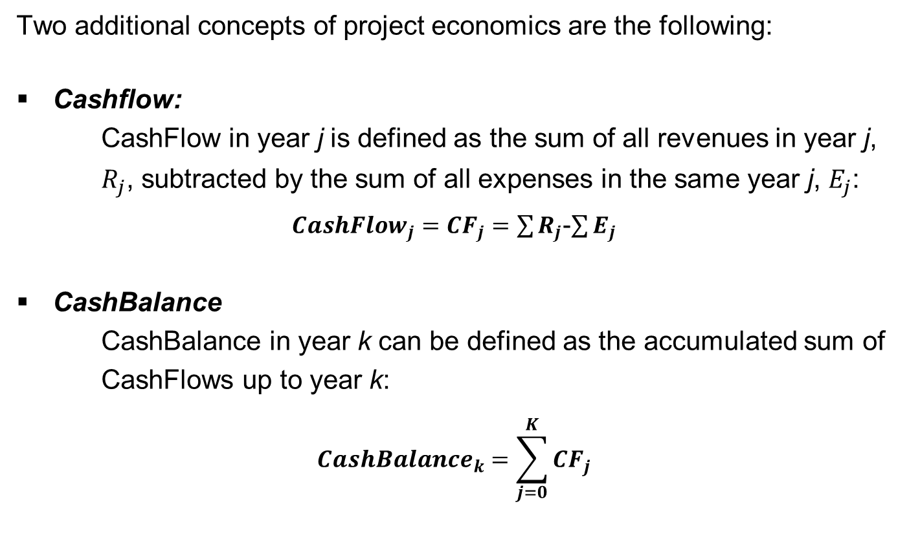
Essential Elements of Project Economics (2)
Two additional concepts of project economics are the following:
Cashflow:
CashFlow in year j is defined as the sum of all revenues in year j, $R_{j}$, subtracted by the sum of all expenses in the same year j, $E_{j}$:
${CashFlow}_{j}={CF}_{j}=\sum{R_{j}}$-$\sum{E_{j}}$
CashBalance
CashBalance in year k can be defined as the accumulated sum of CashFlows up to year k:
$${CashBalance}_{k}=\sum_{j=0}^{K}{{CF}_{j}}$$

Slide 18
Simple Example (1)
Consider the following simple example:
An hypothetical project generates expenses and revenues over a period of 10 years as shown in the following scennario, where the corresponding yearly CashFlows and CashBalances have been calculated:
Note:
The above table comes from the companion Worksheet:
“Simple_Financial_Analysis_MOD_20191028.xlsx”

Slide 19
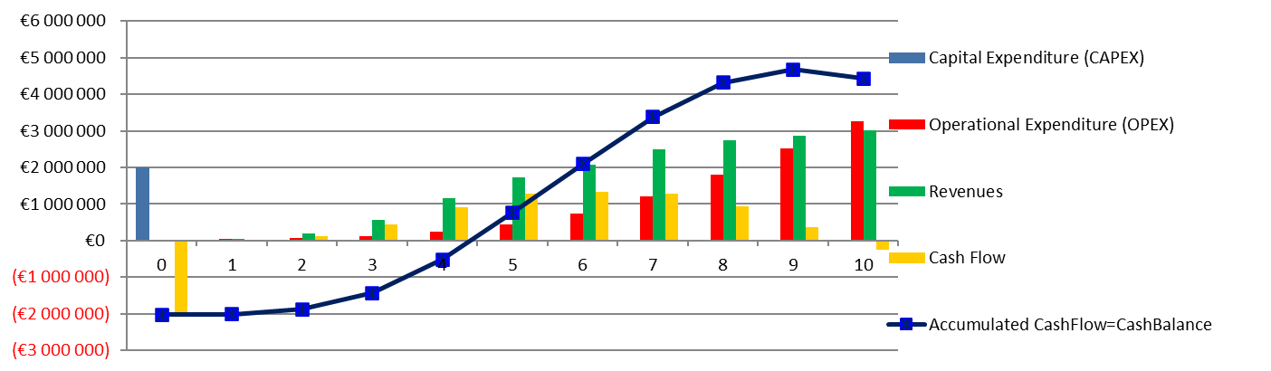
Simple Example (3)
In graphical terms:
Note:
The above table/graph comes from the companion Worksheet:
“Simple_Financial_Analysis_MOD_20191028.xlsx”

Slide 20
Simple Example (4)
However, the above calculations and graphics have “forgotten” an importante mechanism: the effects of time over the flows of money.
As presented above, flows of money in diferente years have been treated as if they had occurred all at the same time.
This is NOT CORRECT…
In fact, if we assume a (positive) flow of cash today, it can be invested still today and begin generating returns immediately making it more valuable than a flow of the same nominal value that only occurs in the future, since between the present moment and the moment of its occurrence, it does not generate any returns.

Slide 21
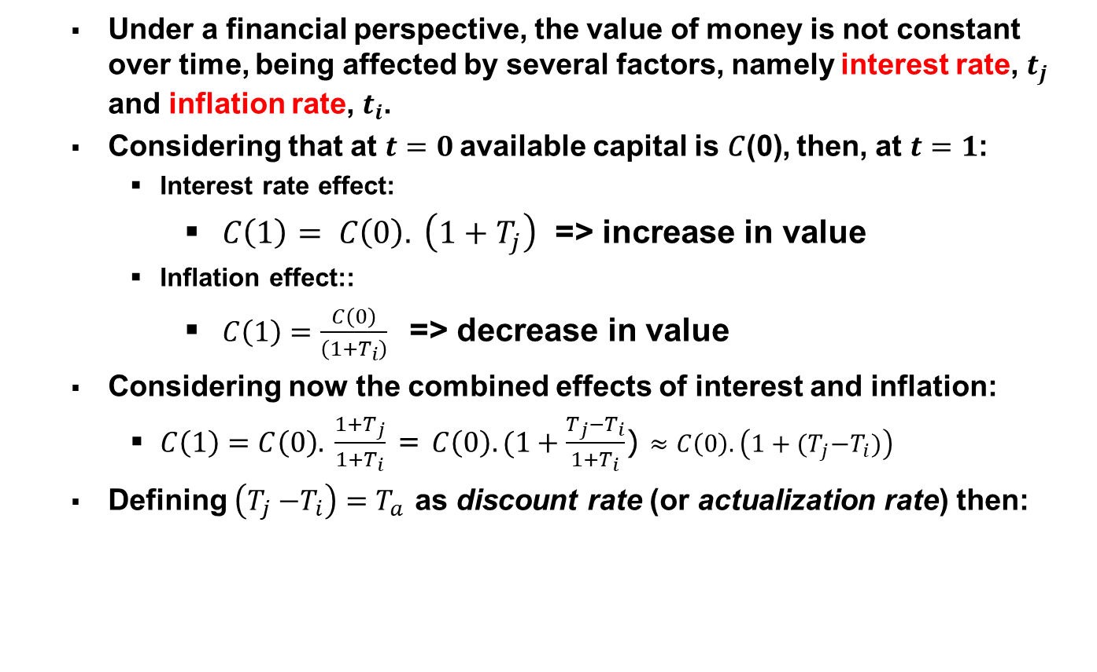
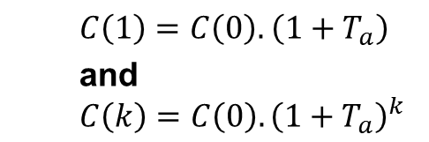
Money Time Vale (1):
Under a financial perspective, the value of money is not constant over time, being affected by several factors, namely interest rate, $t_{j}$ and inflation rate, $t_{i}$.
Considering that at $t=0$available capital is 𝐶(0), then, at $t=1$:
Interest rate effect:
$C\left(1\right)= C\left(0\right).$ $\left(1+T_{j}\right)$ => increase in value
Inflation effect::
$C\left(1\right)=\frac{C\left(0\right)}{\left(1{+T}_{i}\right)}$ => decrease in value
Considering now the combined effects of interest and inflation:
$C\left(1\right)=C\left(0\right).$ $\frac{1{+T}_{j}}{1{+T}_{i}}$ = $C\left(0\right).(1+\frac{T_{j}−T_{i}}{1{+T}_{i}}$) $≈C\left(0\right).\left({1+(T}_{j}{−T}_{i})\right)$
Defining $\left(T_{j}{−T}_{i}\right){=T}_{a}$ as discount rate (or actualization rate) then:
$C\left(1\right)=C\left(0\right).$ $\left(1+T_{a}\right)$
and
$$C\left(k\right)=C\left(0\right).{\left(1+T_{a}\right)}^{k}$$

Slide 22

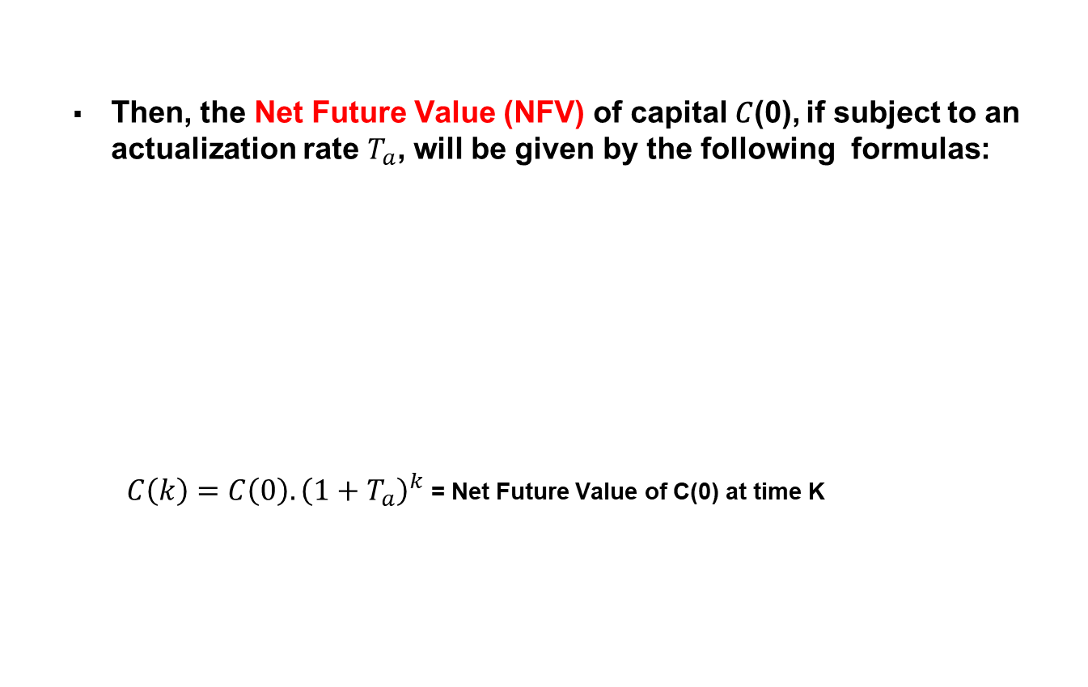




Money Time Vale (2):
Then, the Net Future Value (NFV) of capital 𝐶(0), if subject to an actualization rate $T_{a}$, will be given by the following formulas:
$C\left(k\right)=C\left(0\right).{\left(1+T_{a}\right)}^{k}$= Net Future Value of C(0) at time K
$$t=1$$
C(1)=$C\left(0\right).$ $\left(1+T_{a}\right)$
$$t=2$$
C(2)=$C\left(0\right).{\left(1+T_{a}\right)}^{2}$
$$t=K$$
$$C\left(k\right)=C\left(0\right).{\left(1+T_{a}\right)}^{k}$$
$$t$$
$$t=0$$
$$C(0)$$

Slide 23
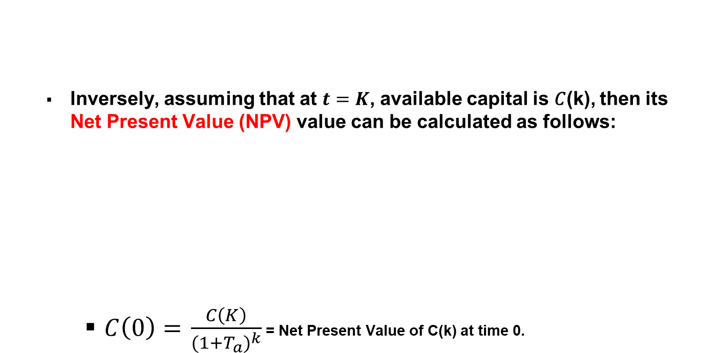
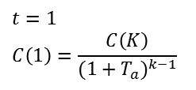
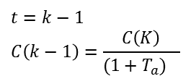

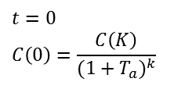
Money Time Vale (3):
Inversely, assuming that at $t=K$, available capital is 𝐶(k), then its Net Present Value (NPV) value can be calculated as follows:
$C\left(0\right)=$ $\frac{C\left(K\right)}{{(1+T_{a})}^{k}}$ = Net Present Value of C(k) at time 0.
$$t=0$$
$$C\left(0\right)=\frac{C\left(K\right)}{{(1+T_{a})}^{k}}$$
$$t=1$$
$$C\left(1\right)=\frac{C\left(K\right)}{{(1+T_{a})}^{k−1}}$$
$$t=k−1$$
$$C\left(k−1\right)=\frac{C\left(K\right)}{{(1+T_{a})}^{}}$$
$$t$$
$$t=K$$
$$C\left(k\right)$$

Slide 24



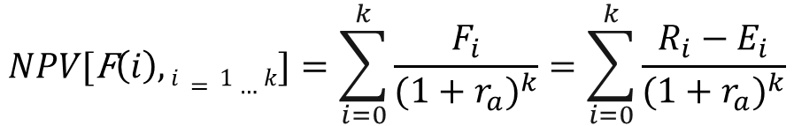


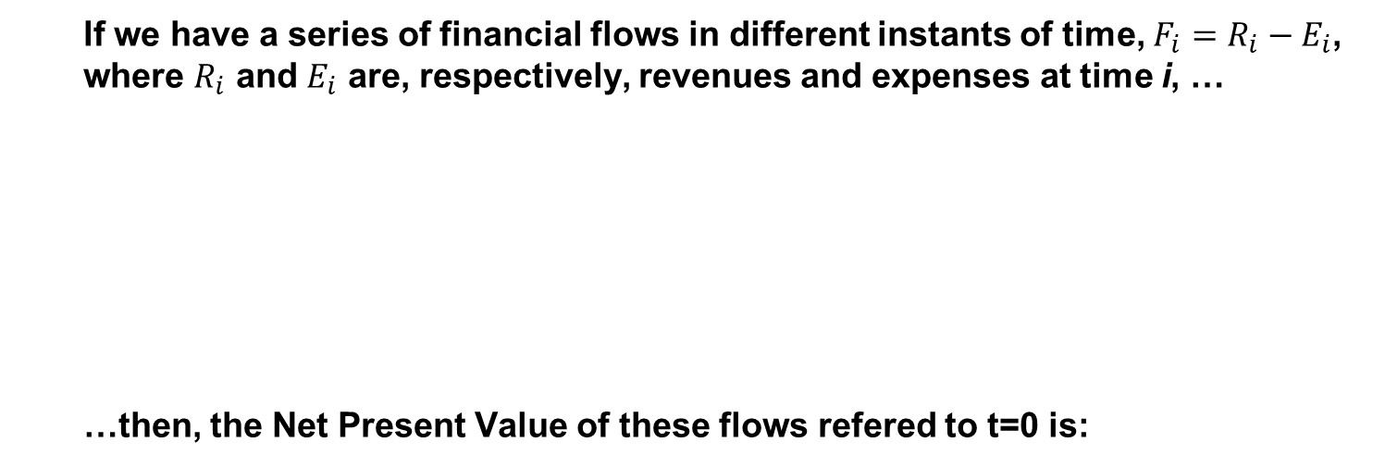

Money Time Vale (4):
If we have a series of financial flows in different instants of time, $F_{i}=R_{i}−E_{i}$, where $R_{i}$ and $E_{i}$ are, respectively, revenues and expenses at time i, …
…then, the Net Present Value of these flows refered to t=0 is:
$$0$$
$$1$$
F$\left(1\right)$
$$2$$
F$\left(2\right)$
$$3$$
F$\left(3\right) …$
F$\left(0\right)$
$$k$$
F$\left(k\right)$
$$NPV\text{[}\text{F}\left(i\right),i=1…k]=\sum_{i=0}^{k}{\frac{F_{i}}{{(1+r_{a})}^{k}}}=\sum_{i=0}^{k}{\frac{R_{i}−E_{i}}{{(1+r_{a})}^{k}}}$$

Slide 25
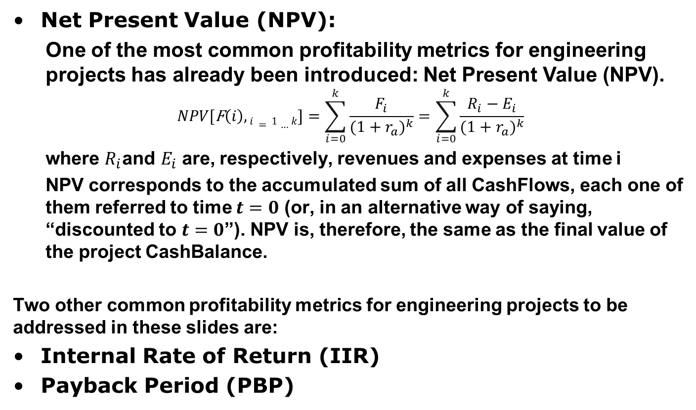
Engineering Projects Profitability Metrics (1)
Net Present Value (NPV):
One of the most common profitability metrics for engineering projects has already been introduced: Net Present Value (NPV).
$$NPV\text{[}\text{F}\left(i\right),i=1…k]=\sum_{i=0}^{k}{\frac{F_{i}}{{(1+r_{a})}^{k}}}=\sum_{i=0}^{k}{\frac{R_{i}−E_{i}}{{(1+r_{a})}^{k}}}$$
where $R_{i}\text{and} E_{i}$ are, respectively, revenues and expenses at time i
NPV corresponds to the accumulated sum of all CashFlows, each one of them referred to time $t=0$ (or, in an alternative way of saying, “discounted to $t=0$”). NPV is, therefore, the same as the final value of the project CashBalance.
Two other common profitability metrics for engineering projects to be addressed in these slides are:
Internal Rate of Return (IIR)
Payback Period (PBP)

Slide 26
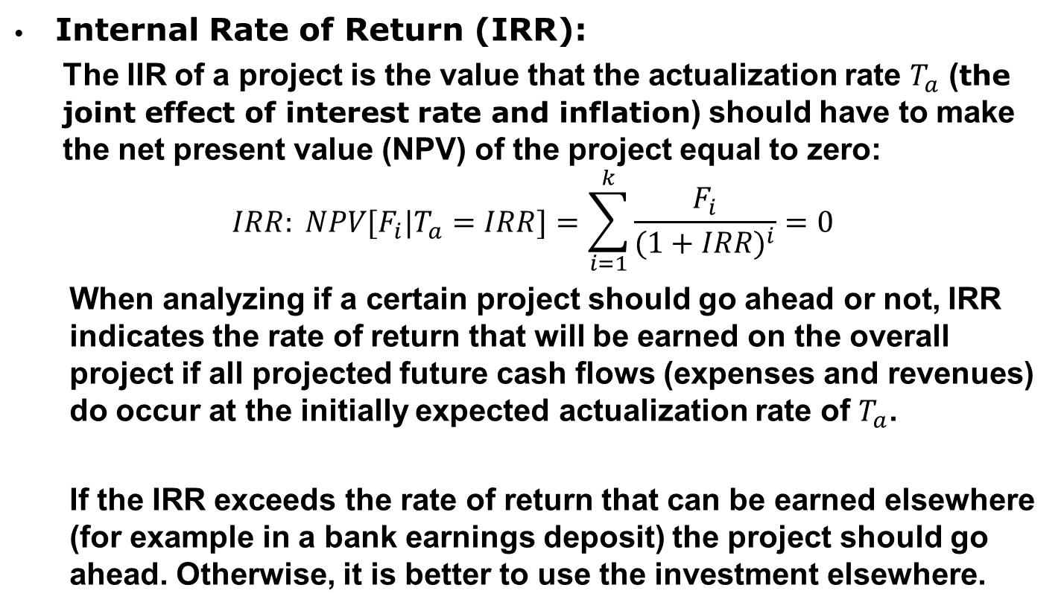
Engineering Projects Profitability Metrics (2)
Internal Rate of Return (IRR):
The IIR of a project is the value that the actualization rate $T_{a}$ (the joint effect of interest rate and inflation) should have to make the net present value (NPV) of the project equal to zero:
$$IRR: NPV{\text{[}F}_{i}|T_{a}=IRR]=\sum_{i=1}^{k}{\frac{F_{i}}{{(1+IRR)}^{i}}=0}$$
When analyzing if a certain project should go ahead or not, IRR indicates the rate of return that will be earned on the overall project if all projected future cash flows (expenses and revenues) do occur at the initially expected actualization rate of $T_{a}$.
If the IRR exceeds the rate of return that can be earned elsewhere (for example in a bank earnings deposit) the project should go ahead. Otherwise, it is better to use the investment elsewhere.

Slide 27
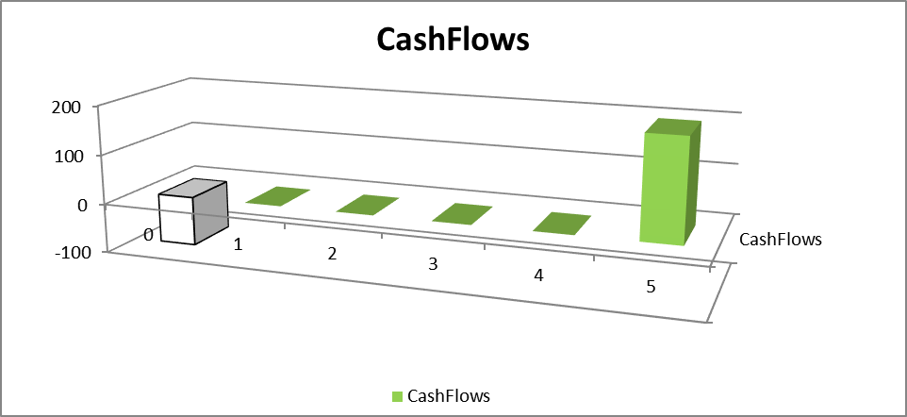
Engineering Projects Profitability Metrics (3)
For an illustration of the concept of IIR let us consider a very simple project with just the 2 cashflows as shown in the following figure:
At a first glance, a project where it is made an initial investment of 100 units of money and returns 200 units of money, even if only after 5 years, seems an “interesting” project… or not?
To answer this question next picture presents the value of the NPV associated with this “project” for different values of the actualization rate.

Slide 28
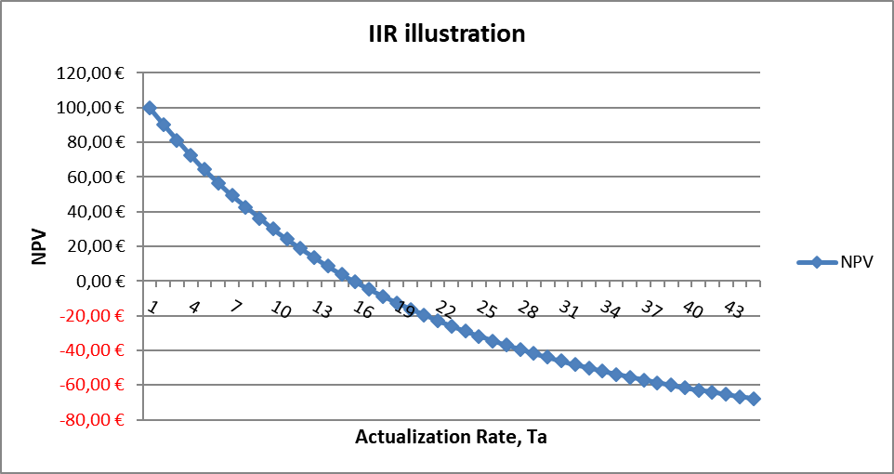

Engineering Projects Profitability Metrics (4)
As can be seen, when $T_{a}$ increases the corresponding NPV decreases and there a value of $T_{a}$ when NPV=0. This value of $T_{a}$ corresponds to the IIR of this “project”.
By visual inspection it can be conclude that for this case, IIR is around 15%.

Slide 29
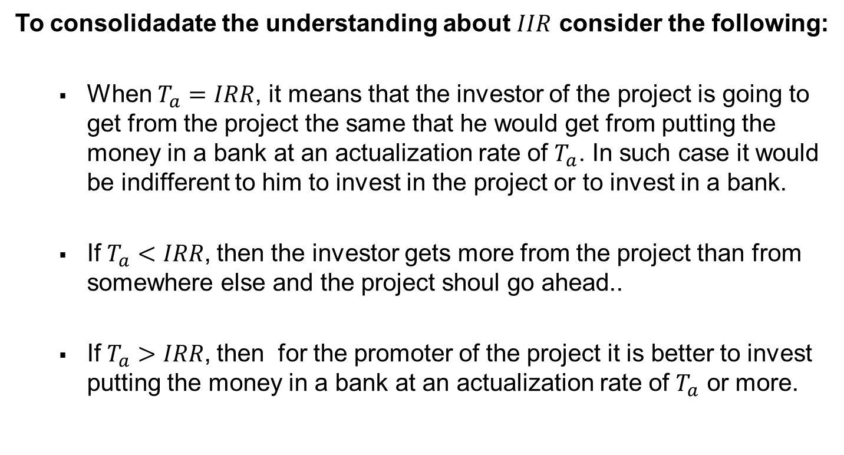
Engineering Projects Profitability Metrics (5)
To consolidadate the understanding about $IIR$ consider the following:
When $T_{a}=IRR$, it means that the investor of the project is going to get from the project the same that he would get from putting the money in a bank at an actualization rate of $T_{a}$. In such case it would be indifferent to him to invest in the project or to invest in a bank.
If$T_{a}<IRR$, then the investor gets more from the project than from somewhere else and the project shoul go ahead..
If$T_{a}>IRR$, then for the promoter of the project it is better to invest putting the money in a bank at an actualization rate of $T_{a}$ or more.

Slide 30
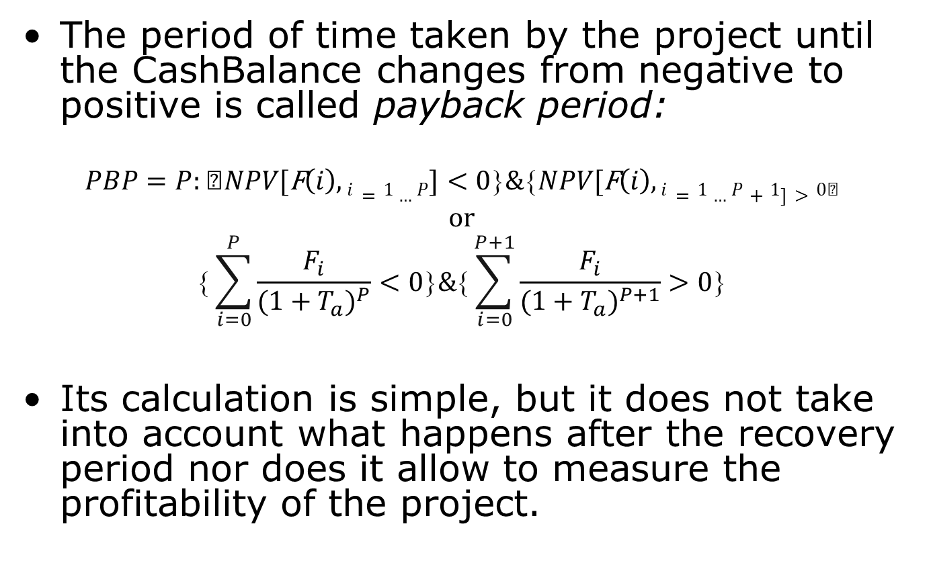
Payback period
The period of time taken by the project until the CashBalance changes from negative to positive is called payback period:
$$PBP=P:NPV\text{[}\text{F}\left(i\right),i=1…P]<0\&NPV\text{[}\text{F}\left(i\right),i=1…P+1]>0$$
or
$$\sum_{i=0}^{P}{\frac{F_{i}}{{(1+T_{a})}^{P}}<0\&\sum_{i=0}^{P+1}{\frac{F_{i}}{{(1+T_{a})}^{P+1}}>0}}$$
Its calculation is simple, but it does not take into account what happens after the recovery period nor does it allow to measure the profitability of the project.

Slide 31
Simple Example Reformulated (1)
It is now time to reformulate the “Simple Example” considered previously taking into account the effects of time over the vlue of Money. That is presented in the following table assuming an actualization rate of 5%.
In the above table have also been included the values of NPV (Net Present Value), IIR (Internal Rate of Return) and PBP (Payback Period)
Note:
The above table/graph comes from the companion Worksheet:
“Simple_Financial_Analysis_MOD_20191028.xlsx”

Slide 32
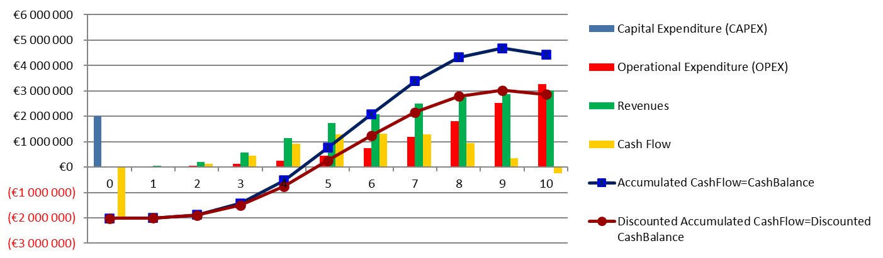
Simple Example Reformulated (2)
The following graphic compares the effects on CashBalance of taking or not taking into account the effects of time:
The curves "Accumulated CashFlow=CashBalance" and "Discounted Accumulated CashFlow=Discounted CashBalance“ refer, respectively to not having and having taken into account the effects of time.

Slide 33
End
…for the time being
duarte@ua.pt

